Slide 1
DSRIP Overview

Slide 2


DSRIP Overview
Delivery System Reform Incentive Payment (DSRIP) program is a state-funded incentive program aimed at transforming the NYS healthcare delivery system for Medicaid and uninsured populations
Goals:
Achieve the Triple AIM: Better Health, Better Health Care, Lower cost
Reduce avoidable ED visits and admissions by 25% by 2020
Transform delivery and payment system to incentivize value over volume
Ensure sustainable delivery system transformation
Key Program Components:
Statewide funding for public hospitals and safety net providers
DSRIP projects selected from a menu of state-defined interventions and designed around needs of the community
Providers will be paid based on their performance towards outcome milestones and statewide metrics
Incorporation of community-based organizations to address the social determinants of health

Slide 3
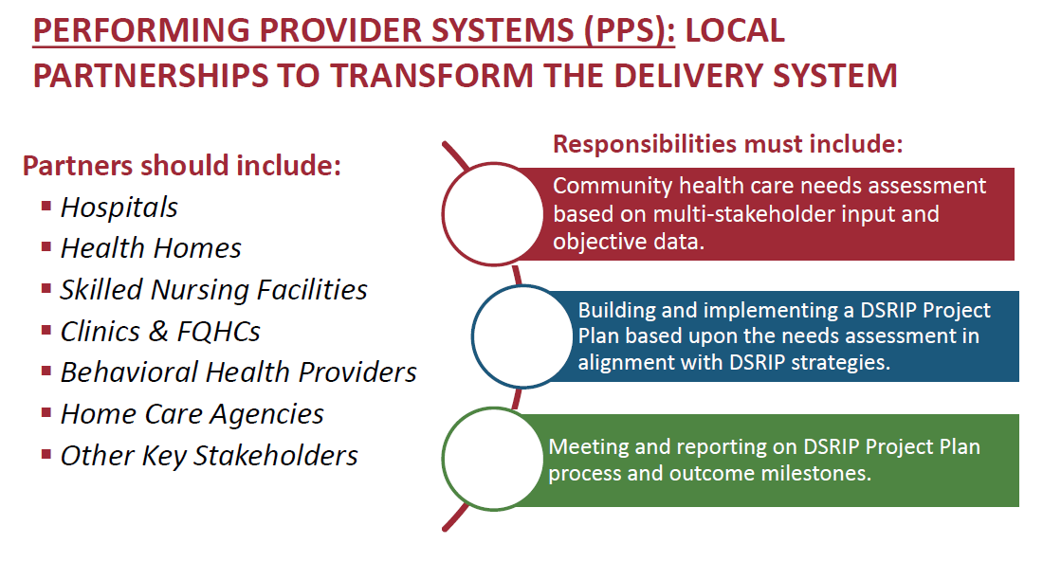
Performing Provider Systems (PPS)

Slide 4

Who Is BPHC?
Led by SBH Health System
Who is BPHC
SBH Health System (SBH) is leading the Bronx Partners for Healthy Communities (BPHC) Performing Provider System
150 years of serving the Bronx
Safety net provider
Over 70% Medicaid patients
Proven commitment to care innovation and health outcome improvement in our underserved community
BPHC represents a diverse network of over 200 member organizations, including:
Hospitals
FQHCs
Health Homes
Home Care Agencies
Behavioral Health Facilities
Long Term Care Facilities
IPAs and Independent Providers
Community Based Organizations

Slide 5
What is BPHC?
205 Unique Organizations
(1,200 Total Locations/Sites)
5 Assisted Living Facility Locations
18 Certified Home Health Agency Locations
30 Diagnostic & Treatment Center Locations
32 Federally Qualified Healthcare Center Locations
2 Long Term Home Health Care Provider Locations
13 Nursing Home Locations
19 OASAS (Article 32) Provider Locations
39 OMH (Article 31) Provider Locations
6 OPWDD (Article 16) Provider Locations
19 Skilled Nursing Facility Locations
9 Sole Community Provider Locations
2 Voluntary Hospitals (33 Locations)
146 Other (i.e. Housing, Hospice, Community Based Organizations, LHCSA, etc.)

Slide 6










The BPHC Ecosystem
Healthcare Providers
Receive funds to support DSRIP activities
Coordinate care within and across services
Implement evidence-based care protocols
Promote patient self-management
Transition to value-based payments
BPHC
Provide centralized support to the PPS :
Project planning
Training and workforce development
Information Technology
Performance analysis, monitoring & improvement
Overseeing finance and budget
Creating governance framework
Manage distribution of DSRIP funds to PPS members
Community-Based Organizations
Provide services to:
Support healthy lifestyle
Improve access to care
Refer patients to PPS providers

Slide 7






The Bronx is Ready for DSRIP
The Bronx is home to:
A large Medicaid population: 59% of residents are covered through Medicaid over the course of the year
A large base of providers spanning the continuum of care
Support from diverse organizations with deep roots in the community
DSRIP provides an opportunity for the Bronx to transition to a truly integrated delivery system.

Slide 8
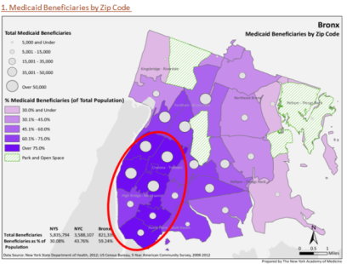
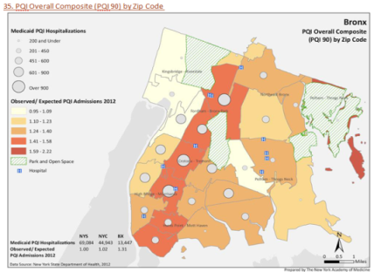
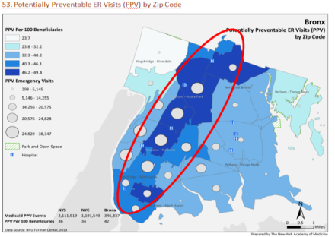
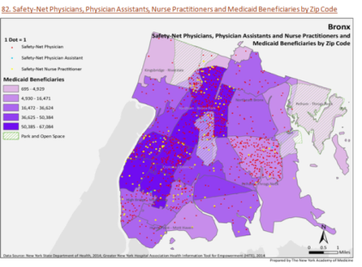
Community Needs Assessment Highlights
High Medicaid enrollment
High preventable admission rates
High preventable ER visit rates
Alignment with safety net providers
~59% of Bronx residents are Medicaid enrollees
Many areas 75%+ Medicaid
High number of dual eligibles
High ratios of PQI admissions
Concentrated along Grand Concourse
High rates of preventable ER visits
Highest rates concentrated in same corridor as PQI admissions
Safety net primary care providers is well aligned with where Medicaid beneficiaries reside.
In the Bronx…
Cardiovascular disease: Top cause of mortality
Diabetes: Short-term diabetes hospitalizations nearly 50% higher than city average
Mental/behavioral health : ~50% of residents feel they lack “available” access
Asthma/COPD: Concentration of young adult asthma and respiratory hospitalizations
Substance abuse: 2nd most common health concern
HIV/AIDs: Higher than average rates

Slide 9
BPHC Projects
Projects selected based on findings in Community Needs Assessment
2.a.i | Create Integrated Delivery Systems
2.a.iii | Health Home At-Risk Intervention Program
2.b.iii | Emergency Department Care Triage
2.b.iv | Care Transitions to Reduce 30 Day Readmissions
3.a.i | Integration of Primary Care Services and Behavioral Health
3.b.i | Evidence-Based Strategies for Managing Adult Population with Cardiovascular Disease
3.c.i | Evidence-Based Diabetes Management
3.d.ii | Expansion of Asthma Home‐Based Self‐Management Program
4.a.iii | Strengthen Mental Health and Substance Abuse Infrastructure Across Systems
4.c.ii | Increase Early Access to, and Retention in, HIV Care
Domain 2
System Transformation
Domain 3
Clinical Improvement
Domain 4
Population-wide

Slide 10
Measuring Our Performance
Measurements of care quality and population health, based on nationally recognized metrics defined by CMS and NY, outlined below. (Additional metrics for each project help achieve these key overarching metrics)
Metric | Description
Potentially Preventable Emergency Room Visits (PPVs) | Measures for emergency room visits that could have been avoided with adequate ambulatory care
Potentially Preventable Re-admissions (PPRs) | Measures for readmissions to a hospital that follows a prior hospital discharge and is clinically related to the prior discharge
Prevention Quality Indicators—Adults (PQIs) | Measures focused on quality of care for certain conditions, including prevented hospitalizations, complications, or more serious disease.
Prevention Quality Indicators—Pediatric (PDIs) | Measures that can be used with hospital inpatient discharge data to provide a perspective on the quality of pediatric healthcare.

Slide 11
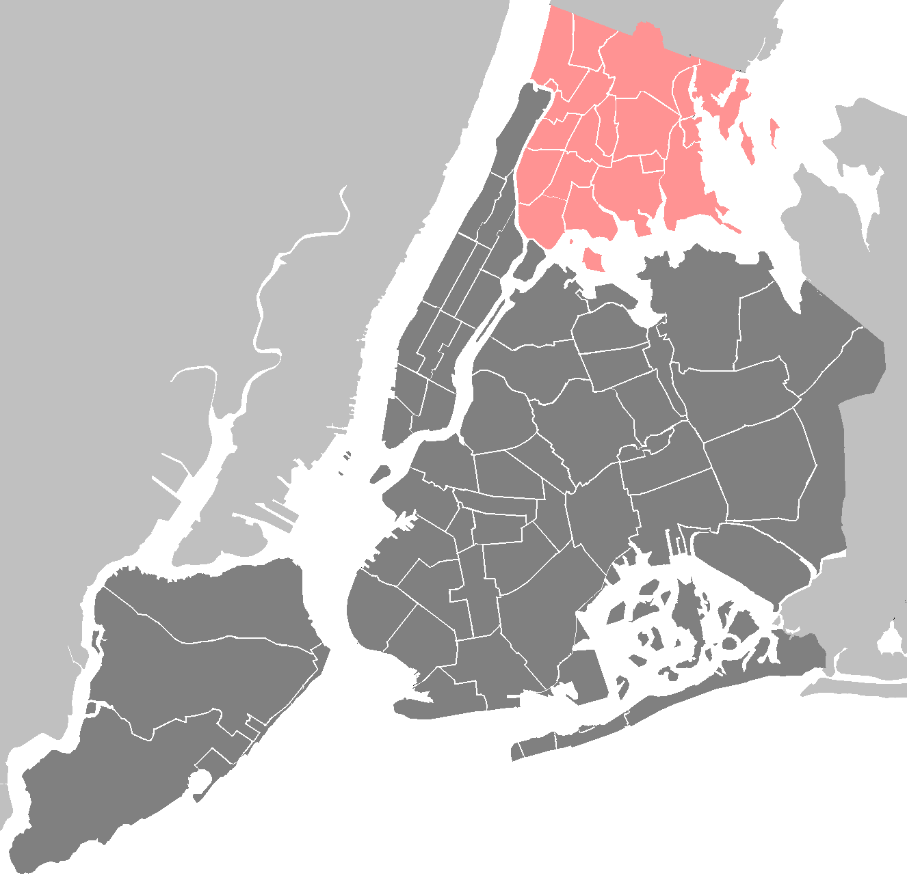
Inter-PPS Collaboration
Bronx Partners for Healthy Communities (BPHC)
OneCity Health (HHC-led PPS)
Bronx Lebanon Hospital Center (BLHC)
Advocate Community Partners (ACP)
BPHC is working with other PPSs in the Bronx to:
Coordinate CNA process (completed)
Align projects (5 common projects selected)
Discuss issues surrounding workforce and community engagement (including data sharing, and care coordination, and cultural competency)
In addition, BPHC is currently collaborating with PPSs outside of the Bronx, including:
8 PPSs throughout NYC on both Domain 4 projects
The Hudson Valley PPS on a coordinated care management IT strategy
Together, the Steering, BOC, and CDPP Committees form the PAC

Slide 12






Thank You!
Please visit our website: www.bronxphc.org
Contact info@bronxphc.org with DSRIP related questions.

