Slide 1


DSRIP & Bronx Partners for Healthy Communities: An Overview
Developed by the BPHC Project Management Office

Slide 2


Overview
New York State (NYS) received federal approval to implement a Delivery System Reform Incentive Payment (DSRIP) program that will provide funding for public and safety net providers to transform the NYS health care delivery system.
Goals:
Achieve the Triple AIM :Better Health, Better Health Care, Lower cost
Transform Delivery and payment system to incentivize value over volume
Ensure delivery system transformation continues beyond the waiver period through managed care payment reform
Key Program Components:
Statewide funding initiative for public hospitals and safety net providers
Only coalitions of community/regional health providers are eligible
DSRIP projects based on a menu of interventions approved by CMS and NYS
Payments to providers based on their performance in meeting outcome milestones and state achieving statewide metrics
Additional information about the NY State DSRIP program can be accessed here: https://www.health.ny.gov/health_care/medicaid/redesign/delivery_system_reform_incentive_payment_program.htm

Slide 3
What is Bronx Partners for Healthy Communities (BPHC)?
BPHC is an emerging Performing Provider System in the Bronx led by SBH Health System. This PPS currently consists of:
160 Unique Organizations
780 Total Locations/Sites
5 Assisted Living Facility Locations
19 Certified Home Health Agency Locations
33 Diagnostic & Treatment Center Locations
32 Federally Qualified Healthcare Center Locations
10 Long Term Home Health Care Provider Locations
13 Nursing Home Locations
23 OASAS (Article 32) Provider Locations
78 OMH (Article 31) Provider Locations
8 OPWDD (Article 16) Provider Locations
19 Skilled Nursing Facility Locations
9 Sole Community Provider Locations
2 Voluntary Hospitals (33 Locations)
501 Other (i.e. Housing, Hospice, Community Based Organizations, LHCSA, etc.)

Slide 4
SBH As Lead Applicant
SBH Health System has received the support and approval to serve as the lead applicant from founding members and the BPHC Steering Committee.
Founding Members
Acacia Network
Bronx United IPA
Institute for Family Health
BPHC Steering Committee
1199 SEIU Healthcare Workers East
Acacia Network
Bronx United IPA
Montefiore Medical Center
Puerto Rican Family Institute
SBH Health System
Union Community Health Center
Centerlight Health System
Institute for Family Health
Montefiore Medical Center
Morris Heights Health Center
Puerto Rican Family Institute
SBH Health System
Union Community Health Center
Visiting Nurse Service of New York
Morris Heights Health Center

Slide 5
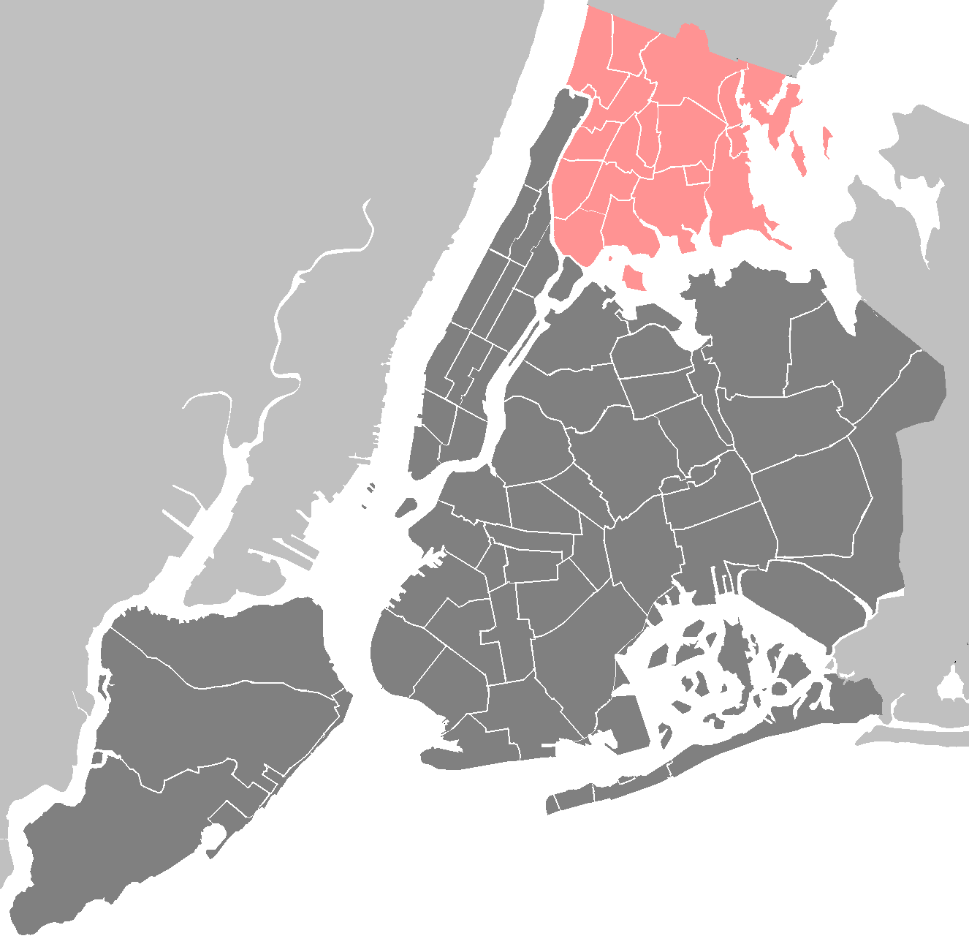
BPHC Geographic Region
The Entire Bronx Borough
Population: Culturally vibrant community with population of ~1.5 million
Medicaid Coverage: Highest rates of Medicaid coverage in the State (59% of Bronx residents over the course of a year)
Population Health: Though the Bronx represents only 7% of the State’s population, it accounts for 22% of asthma hospitalizations and the diabetes mortality rate is 60% higher than the State’s rate
Social Factors: Poorest county in New York State with approximately 30% of residents living in poverty, and a 12% unemployment rate. Over a third of the population has unaffordable or inadequate housing.

Slide 6
Project Advisory Committee Structure and Processes
The Project Advisory Committee acts as the planning governance for BPHC.
SBH
SBH acts as the fiduciary to the State
Steering Committee
Business Operations Committee (BOC)
Clinical Delivery and Program Planning (CDPP) Committee
Care Management and Care Transitions
CVD/Asthma/Diabetes
Primary Care/Behavioral Health Integration
IT & Analytics
Finance
Workforce Development
Population Health
Steering Committee approves all plans brought forward by BOC and CDPP
Together, the Steering, BOC, and CDPP Committees form the PAC
Business Operations work groups* draft plans for the development of centralized services support and infrastructure
Clinical work groups draft project plans to be reviewed by CDPP
*45 organizations are represented on work groups. There is a total of 113 members across the 7 work groups.

Slide 7
Clinical Work Groups and DSRIP Project Assignments
Clinical Work Group
DSRIP Projects
Health home at-risk intervention program
2.a.i
Care Management & Care Transitions
ED care triage for at-risk populations
2.a.iii
Care transitions intervention model to reduce 30 day readmissions for chronic health conditions
2.b.iv
Primary Care/ Behavioral Health Integration
Integration of primary care and behavioral health services
3.a.i
Evidence-based strategies for disease management for cardiovascular health
3.b.i
CVD/Asthma/Diabetes
Evidence-based strategies for disease management for diabetes
3.c.i
Expansion of asthma home-based self-management program
3.d.ii
Strengthen mental health and substance abuse infrastructure across systems
4.a.iii
Population Health
Increase early access to and retention in HIV care
4.c.ii

Slide 8
DSRIP Project Planning Timeline (Year 0)
Project Planning
June 26
Design Grant Application due
August 31
State makes baseline data for DSRIP measures available
December 16
DSRIP Project Plan Application due
October 22
Public comments due on draft DSRIP Project Plan application
Early March
DSRIP Project Plan Awards made
Mid-Nov.
PPS to submit final Network Lists
May 15
Letter of Intent due
August 6
Design Grant Awards made
May 2014
August 2014
December 2014
April 2015
Early Sept.
Initial PPS Attribution Logic Run for PPS*
November 14
State releases final electronic DSRIP Project Plan Application
January 20
Public comments due on DSRIP Project Plan applications
April 1
DSRIP Year 1 begins
September 22
State releases draft DSRIP Project Plan Application and Application Review Tool
Late Nov.-Early Dec.
Final attribution will be made available to PPS
Red text=Pending State deliverables
*Date likely to be delayed
NOTE: Timeline may change at State’s discretion.

