Slide 1


DSRIP & Bronx Partners for Healthy Communities: An Overview
Developed by the BPHC Project Management Office

Slide 2


Overview
New York State (NYS) received federal approval to implement a Delivery System Reform Incentive Payment (DSRIP) program that will provide funding for public and safety net providers to transform the NYS health care delivery system.
Goals:
Achieve the Triple AIM :Better Health, Better Health Care, Lower cost
Transform Delivery and payment system to incentivize value over volume
Ensure delivery system transformation continues beyond the waiver period through managed care payment reform
Key Program Components:
Statewide funding initiative for public hospitals and safety net providers
Only coalitions of community/regional health providers are eligible
DSRIP projects based on a menu of interventions approved by CMS and NYS
Payments to providers based on their performance in meeting outcome milestones and state achieving statewide metrics
Additional information about the NY State DSRIP program can be accessed here: https://www.health.ny.gov/health_care/medicaid/redesign/delivery_system_reform_incentive_payment_program.htm

Slide 3
$8 Billion in New Federal Funding
Overall pot to be allocated, depending on application valuation, into Public Hospital and Safety Net Funds
10% of each fund set-aside for high performance payments in years 2 through 5
Potential Reductions in Federal Funding for Failure to Meet Statewide Metrics,
$381 million

Slide 4
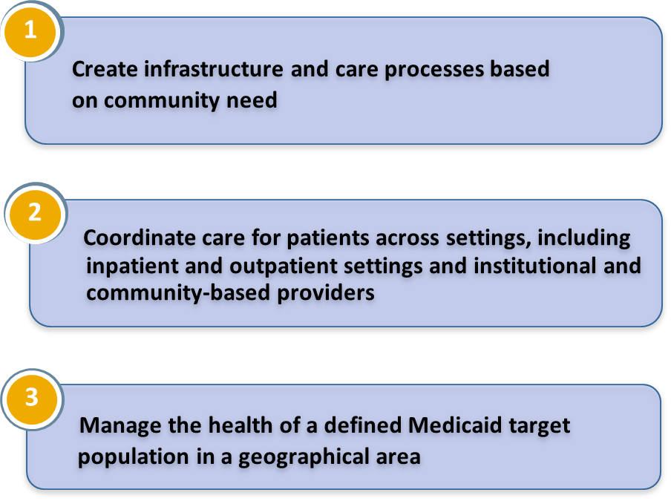
Performing Provider System (PPS)
A PPS is a coalition of providers who may submit an application for DSRIP funding; single providers will not be considered
Each PPS must designate a lead safety net (>35% Medicaid patients) coalition provider and establish clear relationships with provider partners (lead will report to State and CMS)
Each PPS will identify a proposed population whose care they will be responsible for managing
PPS must establish joint budget, funding distribution plan and data sharing agreement
The non-safety net providers in a PPS as a group may not receive more than 5% of a project’s total valuation
PPS Objectives
Only applicants with a triggering event are eligible for a SEP.
Notes:
PPS will be able to apply for funding from one of two DSRIP pools:
Public Hospital Transformation Fund (open to applicants led by a major public hospital system)
Safety Net Performance Provider System Transformation Fund (available to all other DSRIP eligible providers)
Data sharing agreement: to share na manage patient level data on system-wide performance consistent with HIPAA
Partners should include: hospitals, health homes, skilled nursing facilities, clinics, FQHCs, behavioral health providers, home care agencies, other stakeholders

Slide 5
Where do physicians fit into the PPS?
Recognizing the many roles that physicians play in health care, physicians may be involved based upon:
  Role in administration of a health care service provider such as a hospital, clinic, etc
  Role as a physician within a safety net hospital or other facility, FQHC, safety net clinic, Health Home network
  Role as medical director in a Medicaid Managed Care Health Plan
  Role as physician practicing in a practice that meets the safety net definition
  Role as a physician in a non-safety net practice or facility that provides needed services to a PPS
  Role as a physician in a practice or facility that receives a vital access provider exception

Slide 6
What is Bronx Partners for Healthy Communities (BPHC)?
BPHC is an emerging Performing Provider System in the Bronx led by SBH Health System. This PPS currently consists of:
160 Unique Organizations
780 Total Locations/Sites
5 Assisted Living Facility Locations
19 Certified Home Health Agency Locations
33 Diagnostic & Treatment Center Locations
32 Federally Qualified Healthcare Center Locations
10 Long Term Home Health Care Provider Locations
13 Nursing Home Locations
23 OASAS (Article 32) Provider Locations
78 OMH (Article 31) Provider Locations
8 OPWDD (Article 16) Provider Locations
19 Skilled Nursing Facility Locations
9 Sole Community Provider Locations
2 Voluntary Hospitals (33 Locations)
501 Other (i.e. Housing, Hospice, Community Based Organizations, LHCSA, etc.)
Notes:
Would define a PPS first before introducing BPHC, then have something on how BPHC fits into the other emerging PPS’s in the bronx (the last part may be controversial)

Slide 7
SBH As Lead Applicant
SBH Health System has received the support and approval to serve as the lead applicant from founding members and the BPHC Steering Committee.
Founding Members
Acacia Network
Bronx United IPA
Institute for Family Health
BPHC Steering Committee
1199 SEIU Healthcare Workers East
Acacia Network
Bronx United IPA
Montefiore Medical Center
Puerto Rican Family Institute
SBH Health System
Union Community Health Center
Centerlight Health System
Institute for Family Health
Montefiore Medical Center
Morris Heights Health Center
Puerto Rican Family Institute
SBH Health System
Union Community Health Center
Visiting Nurse Service of New York
Morris Heights Health Center

Slide 8
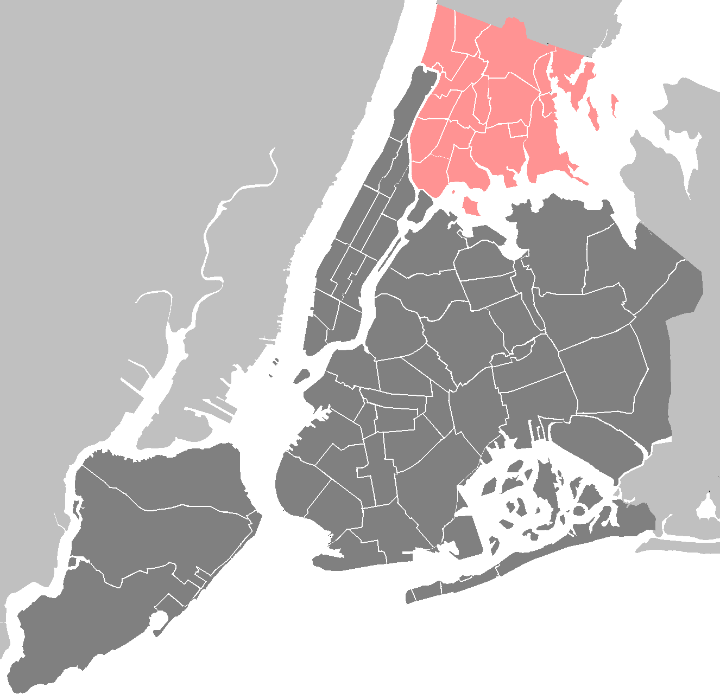
BPHC Geographic Region
The Entire Bronx Borough
Population: Culturally vibrant community with population of ~1.5 million
Medicaid Coverage: Highest rates of Medicaid coverage in the State (59% of Bronx residents over the course of a year)
Population Health: Though the Bronx represents only 7% of the State’s population, it accounts for 22% of asthma hospitalizations and the diabetes mortality rate is 60% higher than the State’s rate
Social Factors: Poorest county in New York State with approximately 30% of residents living in poverty, and a 12% unemployment rate. Over a third of the population has unaffordable or inadequate housing.

Slide 9
Project Advisory Committee Structure and Processes
The Project Advisory Committee acts as the planning governance for BPHC.
SBH
SBH acts as the fiduciary to the State
Steering Committee
Business Operations Committee (BOC)
Clinical Delivery and Program Planning (CDPP) Committee
Care Management and Care Transitions
CVD/Asthma/Diabetes
Primary Care/Behavioral Health Integration
IT & Analytics
Finance
Workforce Development
Population Health
Steering Committee approves all plans brought forward by BOC and CDPP
Together, the Steering, BOC, and CDPP Committees form the PAC
Business Operations work groups* draft plans for the development of centralized services support and infrastructure
Clinical work groups draft project plans to be reviewed by CDPP
  *45 organizations are represented on work groups. There is a total of 113 members across the 7 work groups.

Slide 10

Member Participation in Planning Efforts
From mid-July to today, BPHC has held:
  2 All-Member meetings, involving all BPHC participants
  6 meetings of the committees composing the PAC, involving 36 individuals across 19 member organizations
  19 work group meetings thus far across the 7 work groups
In total, the 7 work groups involve 113 individuals across 45 member organizations

Slide 11
DSRIP Project Planning Timeline (Year 0)
Project Planning
June 26
Design Grant Application due
August 31
State makes baseline data for DSRIP measures available
December 16
DSRIP Project Plan Application due
October 22
Public comments due on draft DSRIP Project Plan application
Early March
DSRIP Project Plan Awards made
Mid-Nov.
PPS to submit final Network Lists
May 15
Letter of Intent due
August 6
Design Grant Awards made
May 2014
August 2014
December 2014
April 2015
Early Sept.
Initial PPS Attribution Logic Run for PPS*
November 14
State releases final electronic DSRIP Project Plan Application
January 20
Public comments due on DSRIP Project Plan applications
April 1
DSRIP Year 1 begins
Red text=Pending State deliverables
*Date likely to be delayed
September 22
State releases draft DSRIP Project Plan Application and Application Review Tool
Late Nov.-Early Dec.
Final attribution will be made available to PPS
NOTE: Timeline may change at State’s discretion.

Slide 12










The DSRIP Ecosystem: BPHC’s Role
PLAN
DSRIP OPERATIONS
POST-DSRIP
PROVIDERS
Execute contracts agreeing to comply with DSRIP program and other requirements
Receive funds to support DSRIP activities
Agree to follow DSRIP clinical protocols and IT requirements
Agree to DSRIP governance rules
STAKEHOLDERS
Refer patients to PPS system
Provide other supports
BPHC/SBH
Provide centralized services, such as:
  Training and workforce development
  IT
  Centralized data repositories and analytics
  Performance monitoring & improvement support
  Regional infrastructure
  Care/Case management
Act as overall operational and fiscal agent
Provide governance framework for effective decision-making

Slide 13
Pay for Performance
Annual improvement targets will use a methodology of reducing the gap to the goal by 10%.
For example, if the baseline data for a measure is 52% and the goal is 90%, the gap to the goal is 38. The target for the project’s first year of performance would be a 3.8% increase in the result (target 55.8%).
Each subsequent year would continue to be set with a target using the most recent year’s data. This will account for smaller gains in subsequent years as performance improves toward the goal or measurement ceiling.
Performing Provider Systems may receive less than their maximum allocation if they do not meet metrics and/or if DSRIP funding is reduced because of the statewide penalty.

Slide 14
Main Types of DSRIP Payments
20%
15%
40%
Process
P4R
P4P
60%
15%
80%
15%
85%
65%
25%
45%
20%
15%
Source: Attachment I – Program Funding and Mechanics
*Note: percentage of total funds based on hitting 100% of all milestones

Slide 15
Statewide Performance and Accountability
Beginning in Year 3, limits on funding available and provider incentive payments may be subject to reductions based on statewide performance.
Statewide performance will be assessed on a pass or fail basis for a set of four milestones.
The state must pass all four milestones to avoid DSRIP reductions.
If penalties are applied, CMS requires the state to reduce funds in an equal distribution, across all DSRIP projects.
The DSRIP high performance fund will not be affected by any penalties.

Slide 16

Resources
NYS Delivery System Reform Incentive Payment (DSRIP) Program Web Site:
http://www.health.ny.gov/health_care/medicaid/redesign/delivery_system_reform_incentive_payment_program.htm
Special Terms and Conditions: http://www.health.ny.gov/health_care/medicaid/redesign/docs/special_terms_and_conditions.pdf
Program Funding and Mechanics Protocol-Attachment I:
http://www.health.ny.gov/health_care/medicaid/redesign/docs/program_funding_and_mechanics.pdf
Strategies and Metrics Menu-Attachment J:
http://www.health.ny.gov/health_care/medicaid/redesign/docs/strategies_and_metrics_menu.pdf
Timeline and Deliverables Schedule: http://www.health.ny.gov/health_care/medicaid/redesign/docs/timeline_deliverables_schedule.pdf
NYS Waiver Amendment Presentation: http://www.health.ny.gov/health_care/medicaid/redesign/docs/waiver_amendment_update_present.pdf

Slide 17






Thank You!
Please visit our website: www.bronxphc.org
Contact info@bronxphc.org with DSRIP related questions.

