Slide 1


DSRIP & Bronx Partners: An Overview
Developed by the BPHC Project Management Office

Slide 2


Overview
New York State (NYS) received federal approval to implement a Delivery System Reform Incentive Payment (DSRIP) program that will provide funding for public and safety net providers to transform the NYS health care delivery system.
Goals:
Achieve the Triple AIM :Better Health, Better Health Care, Lower cost
Transform Delivery and payment system to incentivize value over volume
Ensure delivery system transformation continues beyond the waiver period through managed care payment reform
Key Program Components:
Statewide funding initiative for public hospitals and safety net providers
Only coalitions of community/regional health providers are eligible
DSRIP projects based on a menu of interventions approved by CMS and NYS
Payments to providers based on their performance in meeting outcome milestones and state achieving statewide metrics

Slide 3
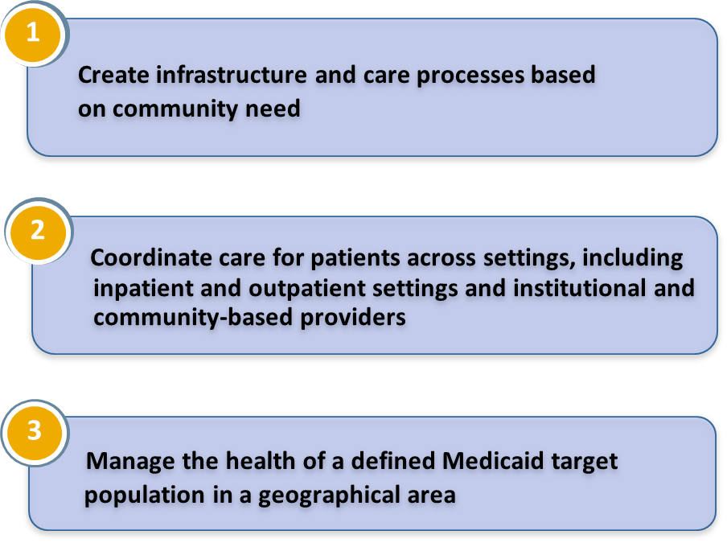
Performing Provider System (PPS)
A PPS is a coalition of providers who may submit an application for DSRIP funding; single providers will not be considered
Each PPS must designate a lead safety net (>35% Medicaid patients) coalition provider and establish clear relationships with provider partners (lead will report to State and CMS)
Each PPS will identify a proposed population whose care they will be responsible for managing
PPS must establish joint budget, funding distribution plan and data sharing agreement
PPS Objectives
Only applicants with a triggering event are eligible for a SEP.

Slide 4
$8 Billion in New Federal Funding
Pre
Between $500-$750 million in funding will be made available to Bronx Performing Provider Systems over the next five years to invest in:
Prevention and Education
Increased access to quality care for diabetes, cancer, cardiovascular disease, and asthma
Addressing violence and behavioral health issues, including anxiety, depression and substance use

Slide 5
Pay for Performance
This is a five-year incentive program
If community health does not improve during years 1-5, Performing Provider Systems may receive less than their maximum award
Statewide Accountability: all Performing Provider Systems in NYS will need to meet their goals in order to receive maximum funding
Year 1 begins April 2015

Slide 6
What is Bronx Partners for Healthy Communities (BPHC)?
Bronx Partners for Healthy Communities, led by SBH Health System, is a collaborative working together to transform healthcare in the Bronx. It currently consists of:
160 Unique Organizations
780 Total Locations/Sites
5 Assisted Living Facility Locations
19 Certified Home Health Agency Locations
33 Diagnostic & Treatment Center Locations
32 Federally Qualified Healthcare Center Locations
10 Long Term Home Health Care Provider Locations
13 Nursing Home Locations
23 OASAS (Article 32) Provider Locations
78 OMH (Article 31) Provider Locations
8 OPWDD (Article 16) Provider Locations
19 Skilled Nursing Facility Locations
9 Sole Community Provider Locations
2 Voluntary Hospitals (33 Locations)
500 Other (i.e. Housing, Hospice, Community Based Organizations, LHCSA, etc.)

Slide 7
SBH As Lead Applicant
SBH Health System has received the support and approval to serve as the lead applicant from founding members and the BPHC Steering Committee.
Founding Members
Acacia Network
Bronx United IPA
Institute for Family Health
BPHC Steering Committee
1199 SEIU Healthcare Workers East
Acacia Network
Bronx United IPA
Montefiore Medical Center
Puerto Rican Family Institute
SBH Health System
Union Community Health Center
Centerlight Health System
Institute for Family Health
Montefiore Medical Center
Morris Heights Health Center
Puerto Rican Family Institute
SBH Health System
Union Community Health Center
Visiting Nurse Service of New York
Morris Heights Health Center

Slide 8
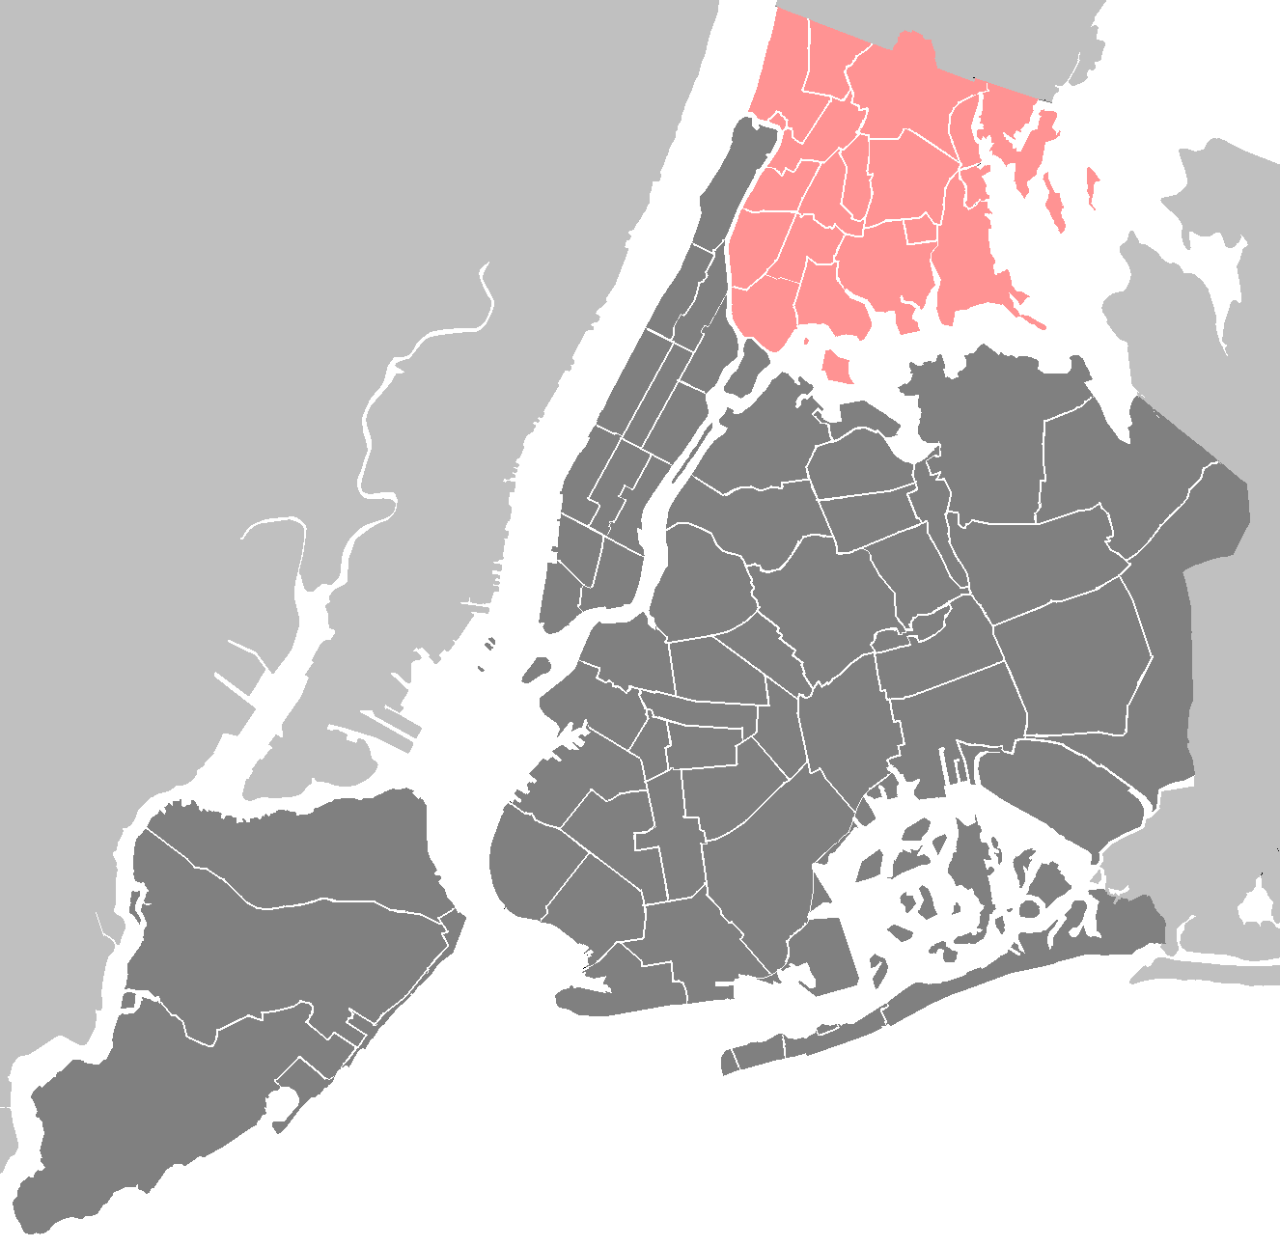
BPHC Geographic Region
The Entire Bronx Borough
Population: Culturally vibrant community with population of ~1.5 million
Medicaid Coverage: Highest rates of Medicaid coverage in the State (59% of Bronx residents over the course of a year)
Population Health: Though the Bronx represents only 7% of the State’s population, it accounts for 22% of asthma hospitalizations and the diabetes mortality rate is 60% higher than the State’s rate
Social Factors: Poorest county in New York State with approximately 30% of residents living in poverty, and a 12% unemployment rate. Over a third of the population has unaffordable or inadequate housing.

Slide 9
Project Advisory Committee Structure and Processes
The Project Advisory Committee acts as the planning governance for BPHC.
SBH
SBH acts as the fiduciary to the State
Steering Committee
Business Operations Committee (BOC)
Clinical Delivery and Program Planning (CDPP) Committee
Care Management and Care Transitions
CVD/Asthma/Diabetes
Primary Care/Behavioral Health Integration
IT & Analytics
Finance
Workforce Development
Population Health
Steering Committee approves all plans brought forward by BOC and CDPP
Together, the Steering, BOC, and CDPP Committees form the PAC
Business Operations work groups* draft plans for the development of centralized services support and infrastructure
Clinical work groups draft project plans to be reviewed by CDPP

Slide 10

Member Participation in Planning Efforts
From mid-July to today, BPHC has held:
  3 All-Member meetings, involving all BPHC participants
  8 meetings of the committees composing the PAC, involving 36 individuals across 19 member organizations
  20 work group meetings thus far across the 7 work groups
In total, the 7 work groups involve 113 individuals across 45 member organizations

Slide 11
For Our Workforce
22,000 additional jobs added to primary care services in NY State in 2013, this increase will be accelerated by DSRIP
Will have more, not less workers
Looking for workforce from the community
Will provide more education and training
Retraining and redeployment means more opportunity

Slide 12
DSRIP Project Planning Timeline (Year 0)
Project Planning
June 26
Design Grant Application due
August 31
State makes baseline data for DSRIP measures available
December 16
DSRIP Project Plan Application due
October 22
Public comments due on draft DSRIP Project Plan application
Early March
DSRIP Project Plan Awards made
Mid-Nov.
PPS to submit final Network Lists
May 15
Letter of Intent due
August 6
Design Grant Awards made
May 2014
August 2014
December 2014
April 2015
Early Sept.
Initial PPS Attribution Logic Run for PPS*
November 14
State releases final electronic DSRIP Project Plan Application
January 20
Public comments due on DSRIP Project Plan applications
April 1
DSRIP Year 1 begins
Red text=Pending State deliverables
*Date likely to be delayed
September 22
State releases draft DSRIP Project Plan Application and Application Review Tool
Late Nov.-Early Dec.
Final attribution will be made available to PPS
NOTE: Timeline may change at State’s discretion.

Slide 13

Resources
NYS Delivery System Reform Incentive Payment (DSRIP) Program Web Site:
http://www.health.ny.gov/health_care/medicaid/redesign/delivery_system_reform_incentive_payment_program.htm
Special Terms and Conditions: http://www.health.ny.gov/health_care/medicaid/redesign/docs/special_terms_and_conditions.pdf
Program Funding and Mechanics Protocol-Attachment I:
http://www.health.ny.gov/health_care/medicaid/redesign/docs/program_funding_and_mechanics.pdf
Strategies and Metrics Menu-Attachment J:
http://www.health.ny.gov/health_care/medicaid/redesign/docs/strategies_and_metrics_menu.pdf
Timeline and Deliverables Schedule: http://www.health.ny.gov/health_care/medicaid/redesign/docs/timeline_deliverables_schedule.pdf
NYS Waiver Amendment Presentation: http://www.health.ny.gov/health_care/medicaid/redesign/docs/waiver_amendment_update_present.pdf

Slide 14






Thank You!
Please visit our website: www.bronxphc.org
Contact info@bronxphc.org with DSRIP related questions.

