Slide 1


DSRIP Overview for SBH Physicians June 10th 2015, 8-9 am Braker Board Room

Slide 2
Introductions
SBH Physicians
Telzak, Edward –Chair of Medicine
Murphy, Daniel – Chair of Emergency Medicine
Troneci, Lizica –Chair of Psychiatry
Kulshreshtha, Manisha –Director of Hospitalist
Rubin, David –Chair of Pediatrics
Patti, Ernest- President Medical Staff
Freije-Ibanez, Pablo- Psychiatry
Payne, Dylan-Psychiatry
CSO Office
Irene Kaufmann, Executive Director CSO
Robin Moon, Senior Director, DSRIP Care Delivery & Practice Innovations
Albert Alvarez, Director of Collaboration
Isaiah Sommers, Communication Coordinator
Jeeny Job, Interim CMO

Slide 3
SBH Physicians and DSRIP
Why are we meeting?
Provide forum for frontline physicians to develop understanding around the DSRIP program
Physicians were selected for their history of leadership and from departments that are directly impacted by DSRIP projects
First session with SBH physicians occurred in May
Guido Macchiavello MD, Primary Care
Bhawesh Patel MD, Primary Care
Dylan Payne MD, Behavioral Health
Jeffrey Lazar MD, ED
Mohammad Azam MD, Inpatient
Explore ideas on how to best share information about DSRIP and BPHC with physicians

Slide 4
Commonly Used Acronyms in DSRIP
DSRIP -Delivery System Reform Incentive Payment Program
PPS-Performing Provider System
IDS-Integrated Delivery System
BPHC-Bronx Partners for Healthy Communities
CSO-Central Services Organization

Slide 5
DSRIP Overview
What is DSRIP (Delivery System Reform Incentive Payment Program)?
Incentive program to transform the healthcare delivery system for Medicaid and uninsured populations
Goal of promoting health of populations while reducing high cost care, specifically in ED and Hospital settings (Triple Aim)
At the end of 5 years, NYS must demonstrate 25% reduction in avoidable ED visits, admissions and readmissions
How is the program funded?
CMS has negotiated with individual states to reinvest Medicaid savings into delivery system reform (MRT waiver)
New York’s application for this reform was approved in April of 2014 with $8 billion allocated for the program
Notes:
May want to add language about PQI,PPR,PPV, PDI

Slide 6
DSRIP Overview cont.
How do Providers participate in the DSRIP program?
Providers need to join regional coalitions called a PPS (Performing Provider System)
PPS must achieve performance benchmarks to receive incentive payments
PPS’s are typically led by safety net hospitals
PPS members include a variety of organizations that provide health services, including CBO’s who address social determinants of health
25 PPS’s in NYS with further consolidation possible
A PPS selects projects from a menu of 44 projects that NYS has defined
Each project has metrics/deliverables that trigger payments
Project selection guided by a community needs assessment
How is SBH participating in DSRIP?
SBH is the lead hospital in a PPS called BPHC (Bronx Partners for Healthy Communities)

Slide 7
BPHC: Who We Are
BPHC comprises 211 unique organizations and over 5,500 providers who will manage the care of 270,000 Medicaid beneficiaries living in the Bronx through New York State’s Delivery System Reform Incentive Program (DSRIP)
Founding members
Acacia Network
Bronx United IPA
Institute for Family Health
Montefiore Medical Center
Morris Heights Health Center
Puerto Rican Family Institute
SBH Health System
Union Community Health Center

Slide 8
BPHC: Who We Are
BPHC’s network includes a wide array of organizations and services:
Hospitals
Primary and specialty care services
Behavioral health and substance abuse services
Long term care and assisted living facilities
Home care agencies
Health homes
IPAs
Community-based organizations (e.g., services for the developmentally disabled, housing, adult day care centers, advocacy, foster care, meal delivery, food banks, legal aid, counseling, youth development)
Educational institutions
Pharmacies
Unions
Health plans
Central Services Organization (CSO) supports the work of BPHC

Slide 9
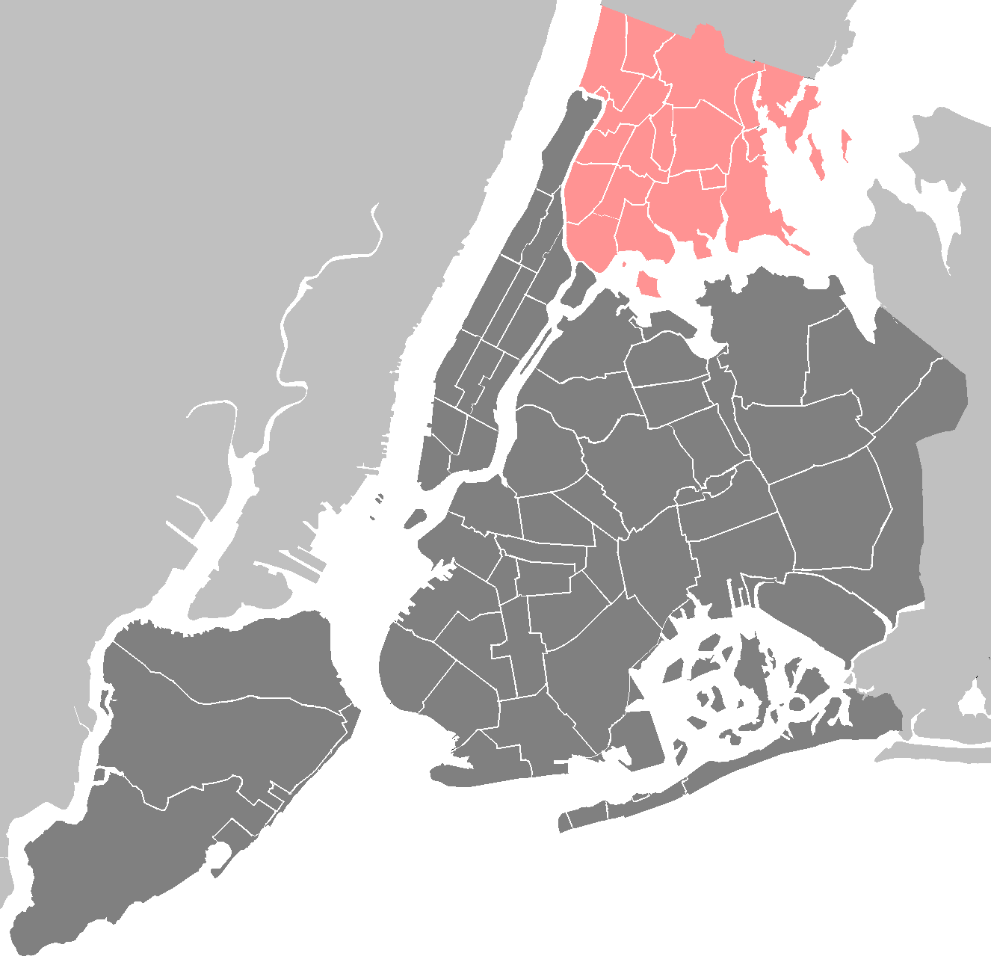
BPHC Geographic Region
The Entire Bronx Borough
Population: Culturally vibrant community with population of ~1.5 million
Medicaid Coverage: Highest rates of Medicaid coverage in the State (59% of Bronx residents over the course of a year)
Population Health: Though the Bronx represents only 7% of the State’s population, it accounts for 22% of asthma hospitalizations and the diabetes mortality rate is 60% higher than the State’s rate
Social Factors: Poorest county in New York State with approximately 30% of residents living in poverty, and a 12% unemployment rate. Over a third of the population has unaffordable or inadequate housing.

Slide 10
Community Needs Assessment (CNA) Highlights
NYAM completed the Bronx-wide CNA in early October. Key findings include…
Health in the Bronx
Socioeconomic Factors
The Bronx is the least healthy county in New York State with high rates of chronic disease such as:
Diabetes
Cardiovascular disease
Respiratory disease including asthma/COPD
Cancer and high rates of obesity
The Bronx outpaces NYC overall in household poverty and low educational attainment.
More than half of the Bronx population speaks a language other than English in the home.
Many of these people are immigrants, presenting possible additional cultural and legal challenges to health care access.
Among the Medicaid population, the Bronx ranks highest among all boroughs in NYC in the rate of potentially preventable inpatient admissions, including for chronic conditions overall.
The link between depression and poverty was also particularly obvious, as people worried about jobs, housing, entitlements, and the safety of their streets.
A dramatic indicator of poverty, with obvious health implications is food security, which was described by multiple respondents.
The costs incurred—in both time and money—for medical care remain very problematic and act as a barrier to effective use of prevention and disease management services from the perspective of community members.
Notes:
Used to drive selection of projects

Slide 11

Bronx CNA Project-Specific Highlights
Cardiovascular disease: Heart disease is the top cause of mortality among the white, black, and Hispanic populations of the Bronx. It is also the second leading cause of premature death in the borough.
Diabetes: The rate of hospitalizations for short-term diabetes complications among Medicaid beneficiaries is higher in the Bronx (151.22 per 100,000) than in the city overall (105.03 per 100,000), and higher than the state overall (110.31 per 100,000).
Asthma/COPD: While the observed rate of PQI respiratory admissions has declined in the Bronx since 2009, it remains at or above the expected rate.
There is a concentration of young adult asthma and respiratory hospitalizations in the southern part of the borough, extending across both sides of the Grand Concourse.
Mental/behavioral health: Only 53.3% of respondents reported that the mental health services are “available” or “very available” in their community.
Substance abuse: Substance abuse was the second most commonly cited health concern by survey respondents (47.2%)
Many (36.2%) also noted the need for education on the topic.
HIV/AIDS: Four neighborhoods in the borough have a higher HIV/AIDS prevalence rate than the city as a whole: High Bridge/ Morrisania, Crotona/ Tremont, Fordham/ Bronx Park, and Hunts Point/ Mott Haven.
Data from the CNA support our project selections

Slide 12
BPHC’s DSRIP Projects
2.a.i | Create Integrated Delivery Systems
2.a.iii | Health Home At-Risk Intervention Program
2.b.iii | Emergency Department Care Triage
2.b.iv | Care Transitions to Reduce 30-Day Readmissions
3.a.i | Integration of Primary Care Services and Behavioral Health
3.b.i | Evidence-Based Strategies for Managing Adult Population with Cardiovascular Disease
3.c.i | Evidence-Based Strategies for Managing Adult Population with Diabetes
3.d.ii | Expansion of Asthma Home‐Based Self‐Management Program
4.a.iii | Strengthen Mental Health and Substance Abuse Infrastructure Across Systems
4.c.ii | Increase Early Access to, and Retention in, HIV Care
Domain 2
System Transformation
Domain 3
Clinical Improvement
Domain 4
Population-wide

Slide 13
Q+A

Slide 14
Discussion
Feedback on this session
Is this information valuable to you?
Is there more information we need to provide for the session to be valuable?
Future Topics?
Input for future engagement
What is the best forum/format to continue future communication?
If not, what information do you need to become comfortable?
Are there forums that you can update your peers with this information?

Slide 15





Please visit our website: www.bronxphc.org

