Slide 1
BPHC Overview for Physicians

Slide 2
Commonly Used Acronyms in DSRIP
DSRIP -Delivery System Reform Incentive Payment Program
PPS-Performing Provider System
IDS-Integrated Delivery System
BPHC-Bronx Partners for Healthy Communities
CSO-Central Services Organization

Slide 3
DSRIP Overview
  What is DSRIP (Delivery System Reform Incentive Payment Program)?
  Incentive program to transform the healthcare delivery system for Medicaid and uninsured populations
  Goal of promoting health of populations while reducing high cost care, specifically in ED and Hospital settings (Triple Aim)
  At the end of 5 years, NYS must demonstrate 25% reduction in avoidable ED visits, admissions and readmissions
How is the program funded?
  CMS has negotiated with individual states to reinvest Medicaid savings into delivery system reform (MRT waiver)
  New York’s application for this reform was approved in April of 2014 with $8 billion allocated for the program
Notes:
May want to add language about PQI,PPR,PPV, PDI

Slide 4
DSRIP Overview cont.
How do Providers participate in the DSRIP program?
  Providers need to join regional coalitions called a PPS (Performing Provider System)
    PPS must achieve performance benchmarks to receive incentive payments
    PPS’s are typically led by safety net hospitals
    PPS members include a variety of organizations that provide health services, including CBO’s who address social determinants of health
    25 PPS’s in NYS with further consolidation possible
  A PPS selects projects from a menu of 44 projects that NYS has defined
    Each project has metrics/deliverables that trigger payments
    Project selection guided by a community needs assessment
How is SBH participating in DSRIP?
  SBH is the lead hospital in a PPS called BPHC (Bronx Partners for Healthy Communities)

Slide 5
BPHC: Who We Are
BPHC comprises 211 unique organizations and over 5,500 providers who will manage the care of 270,000 Medicaid beneficiaries living in the Bronx through New York State’s Delivery System Reform Incentive Program (DSRIP)
Founding members
  Acacia Network
  Bronx United IPA
  Institute for Family Health
  Montefiore Medical Center
  Morris Heights Health Center
  Puerto Rican Family Institute
  SBH Health System
  Union Community Health Center

Slide 6
BPHC: Who We Are
BPHC’s network includes a wide array of organizations and services:
  Hospitals
  Primary and specialty care services
  Behavioral health and substance abuse services
  Long term care and assisted living facilities
  Home care agencies
  Health homes
  IPAs
  Community-based organizations (e.g., services for the developmentally disabled, housing, adult day care centers, advocacy, foster care, meal delivery, food banks, legal aid, counseling, youth development)
  Educational institutions
  Pharmacies
  Unions
  Health plans
Central Services Organization (CSO) supports the work of BPHC

Slide 7
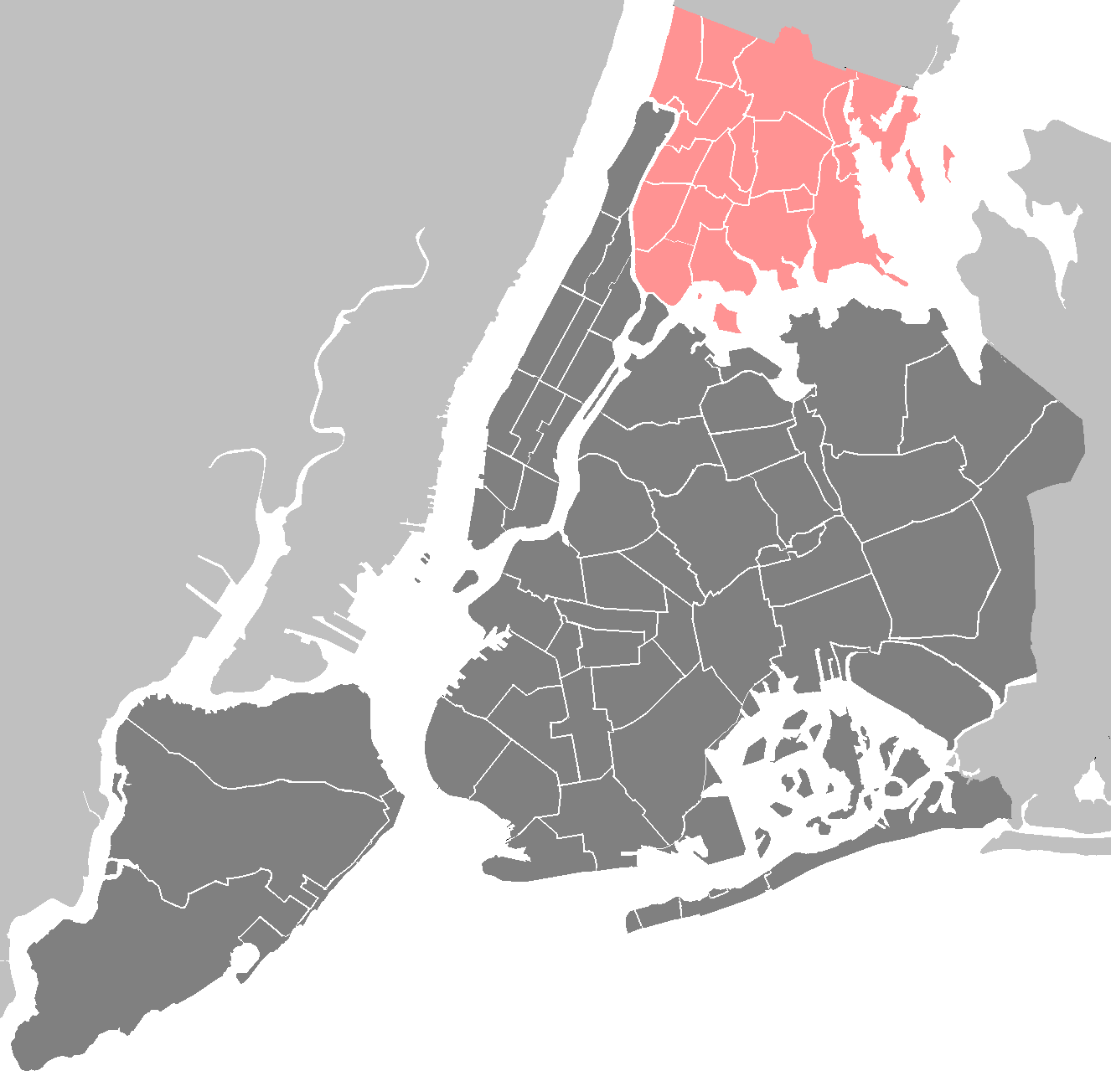
BPHC Geographic Region
The Entire Bronx Borough
Population: Culturally vibrant community with population of ~1.5 million
Medicaid Coverage: Highest rates of Medicaid coverage in the State (59% of Bronx residents over the course of a year)
Population Health: Though the Bronx represents only 7% of the State’s population, it accounts for 22% of asthma hospitalizations and the diabetes mortality rate is 60% higher than the State’s rate
Social Factors: Poorest county in New York State with approximately 30% of residents living in poverty, and a 12% unemployment rate. Over a third of the population has unaffordable or inadequate housing.

Slide 8
Community Needs Assessment (CNA) Highlights
NYAM completed the Bronx-wide CNA in early October. Key findings include…
Health in the Bronx
Socioeconomic Factors
The Bronx is the least healthy county in New York State with high rates of chronic disease such as:
  Diabetes
  Cardiovascular disease
  Respiratory disease including asthma/COPD
  Cancer and high rates of obesity
The Bronx outpaces NYC overall in household poverty and low educational attainment.
More than half of the Bronx population speaks a language other than English in the home.
  Many of these people are immigrants, presenting possible additional cultural and legal challenges to health care access.
Among the Medicaid population, the Bronx ranks highest among all boroughs in NYC in the rate of potentially preventable inpatient admissions, including for chronic conditions overall.
The link between depression and poverty was also particularly obvious, as people worried about jobs, housing, entitlements, and the safety of their streets.
A dramatic indicator of poverty, with obvious health implications is food security, which was described by multiple respondents.
The costs incurred—in both time and money—for medical care remain very problematic and act as a barrier to effective use of prevention and disease management services from the perspective of community members.
Notes:
Used to drive selection of projects

Slide 9

Bronx CNA Project-Specific Highlights
Cardiovascular disease: Heart disease is the top cause of mortality among the white, black, and Hispanic populations of the Bronx. It is also the second leading cause of premature death in the borough.
Diabetes: The rate of hospitalizations for short-term diabetes complications among Medicaid beneficiaries is higher in the Bronx (151.22 per 100,000) than in the city overall (105.03 per 100,000), and higher than the state overall (110.31 per 100,000).
Asthma/COPD: While the observed rate of PQI respiratory admissions has declined in the Bronx since 2009, it remains at or above the expected rate.
There is a concentration of young adult asthma and respiratory hospitalizations in the southern part of the borough, extending across both sides of the Grand Concourse.
Mental/behavioral health: Only 53.3% of respondents reported that the mental health services are “available” or “very available” in their community.
Substance abuse: Substance abuse was the second most commonly cited health concern by survey respondents (47.2%)
  Many (36.2%) also noted the need for education on the topic.
HIV/AIDS: Four neighborhoods in the borough have a higher HIV/AIDS prevalence rate than the city as a whole: High Bridge/ Morrisania, Crotona/ Tremont, Fordham/ Bronx Park, and Hunts Point/ Mott Haven.
Data from the CNA support our project selections

Slide 10
BPHC’s DSRIP Projects
2.a.i | Create Integrated Delivery Systems
2.a.iii | Health Home At-Risk Intervention Program
2.b.iii | Emergency Department Care Triage
2.b.iv | Care Transitions to Reduce 30-Day Readmissions
3.a.i | Integration of Primary Care Services and Behavioral Health
3.b.i | Evidence-Based Strategies for Managing Adult Population with Cardiovascular Disease
3.c.i | Evidence-Based Strategies for Managing Adult Population with Diabetes
3.d.ii | Expansion of Asthma Home‐Based Self‐Management Program
4.a.iii | Strengthen Mental Health and Substance Abuse Infrastructure Across Systems
4.c.ii | Increase Early Access to, and Retention in, HIV Care
Domain 2
System Transformation
Domain 3
Clinical Improvement
Domain 4
Population-wide

Slide 11





Please visit our website: www.bronxphc.org

Slide 12
Appendix

Slide 13




BPHC Governance Structure
Executive Committee
Oversight of overall DSRIP Program implementation
Satisfaction of key metrics to realize incentives
Development of Program vision and implementation of “rules of the road”
Representative of the PPS (though some partners may not have a direct representative )
Involvement of executives with ability to commit their organizations to decisions and provide leadership
Oversight of PPS financial management
Subcommittees
Finance and Sustainability
Quality and Care Innovation
Information Technology
Workforce
Make recommendations on distribution of Project Partner Implementation Funds and Community Good Pool (approved by Exec Committee and SBH)
  Create and update clinical processes and protocols applicable to all Partners
Create and update IT processes and protocols applicable to all Partners
Develop and implement a comprehensive workforce strategy
Ad Hoc Subcommittees may be convened on an as-needed basis.

Slide 14



CSO Operational Functions
Patient & Provider Engagement
Patient outreach
Patient screening, assessment & enrollment
Care plan governance
Care planning and other provider support
Registry management & governance
Data & Analytics
Population risk modeling
Data / trend reporting
Metrics computation / tracking
Partner performance feedback
Clinical Supervision
Provider network development
Protocol development (interventions / practices, care planning, etc.)
Risk stratification
Target population identification
Protocol compliance
Performance monitoring & improvement
Information Technology
Regional IT infrastructure strategic planning
HIT, HIE, and telehealth support (implementation & help desk)
Central data management
Workforce, Staffing & Training
Workforce planning & development strategy
Provider & care coordination staff recruiting / deployment
Training
Financial / Program Management
Fiscal agent / funds distribution functions
Network management / contracting
Financial evaluation
Sustainability and value-based payment planning
PMO & communications

Slide 15










The DSRIP Ecosystem: BPHC’s Role
PROVIDERS
Execute contracts agreeing to comply with DSRIP program and other requirements
Receive funds to support DSRIP activities
Agree to follow DSRIP clinical protocols and IT requirements
Agree to DSRIP governance rules
STAKEHOLDERS
Refer patients to PPS system
Provide other supports
BPHC/SBH
Provide centralized services, such as:
  Training and workforce development
  IT
  Centralized data repositories and analytics
  Performance monitoring & improvement support
  Regional infrastructure
  Care/Case management
Act as overall operational and fiscal agent
Provide governance framework for effective decision-making

Slide 16


Update: Primary Care and Behavioral Health Integration Workgroup
At a Glance
Meetings: Held four Work Group meetings on 7/30, 8/14, 8/27, 9/8
Intervention Recommendations to Date
The Primary Care and Behavioral Health Work Group recommends...
  PCMH
  IMPACT / Collaborative Care Model
  Co-location of Primary Care Providers into Article 31/32 Sites
  Co-location of Behavioral Health Providers into Article 28 Sites
  Achieving 2014 NCQA Level 3 patient-centered medical homes (PCMHs) across BPHC primary care sites by December 2016
  Utilizing the IMPACT/CCM for a subset of patients with mild/moderate depression. Work group members see potential to phase in treatment of anxiety, substance use and other disorders over time as providers gain experience
  Pursuing physical co-location of services where logistically feasible and financially sustainable
  Instituting medical monitoring at locations where co-location is not feasible
  Pursuing physical co-location of services where logistically feasible and financially sustainable
  These sites would also adopt the Collaborative Care model

Slide 17
Deeper Dive: Primary Care – Behavioral Health Interventions
  IMPACT/Collaborative Care Model
  Program Overview/Goal: Evidenced-based approach that integrates mental health treatment into primary care and improves physical and social functioning, while cutting costs. Model targets individuals with depressive symptoms
  Program Model:
    Key component of model is collaborative care team
    Team comprised of patient, provider, care manager and consulting psychiatrist. Utilizes high level of coordination/communication around shared care plans
    Team provides treatment to target and stepped care, and systematically tracks outcomes at patient and population level
    Patients are treated with set of evidence-based psychotherapy and medical treatments, such as problem solving treatment, cognitive behavioral therapy, and medication
  Implementation/Expansion Considerations:
    Coordinating with existing care management (e.g. Health Homes) to achieve ‘One Care Manager per Patient’ model
    Leveraging phased approach to expand to more complex conditions (seriously mentally ill/substance abuse)
    Creating a more robust patient engagement and assessment strategy that includes social determinants
    Utilizing peer support and warm hand-offs to ensure effective referrals
    Target population will include adolescents

Slide 18
Deeper Dive: Primary Care – Behavioral Health Interventions
  Co-Location of Primary Care into Article 31/32; Co-location of Behavioral Health into Article 28
  Program Overview/Goal: Achieve physical co-location of services where logistically feasible and financially sustainable. Aims to improve quality and coordination of care and decrease the number of “no-shows” appointments
  .
  Program Model:
  Primary care and behavioral health services are offered in the same physical location for adults,
  adolescents and children
  Each practice has a process for referring patients from primary care to behavioral health services
  PCPs and BH providers consult each other regularly and informally when making decisions
  Strong links to Health Homes for patient referral as needed
  Where physical co-location is not feasible, consider:
    Integrating health monitoring into BH sites (i.e., metabolic disorders, blood pressures, labs)
    Regular teleconferencing between PCPs and BH providers for at risk patients
  Implementation/Expansion Considerations:
    Infrastructure challenges to meet full scope of service needs, particularly for Article 31 sites
    Staffing shortages
    PCP discomfort with administration of BH medications and therapies
    Cultural barriers to physical integration
    Coordination with existing care management (e.g. Health Homes) to achieve ‘One Care Manager per Patient’ model
    Regulatory relief

Slide 19



Update: Care Management - Care Transitions Workgroup
At a Glance
Meetings: Held four Work Group meetings on 7/30, 8/11, 9/22, and 10/6
Small Group Meetings: Held a series of small group meetings to conduct information gathering with community leaders who have experience implementing the interventions
Intervention Recommendations to Date
The Care Management-Care Transitions Work Group recommends...
  30 Day Readmissions
  ED Triage/Diversion
  Health Homes
  Pursuing:
  Bronx Collaborative
  Critical Time Intervention
  Pursuing:
  Expansion of Montefiore CMO Clinical Navigator Program
  Parachute NYC
  Continuing research on Community Paramedicine
  Pursuing:
  Opportunities to strengthen current capabilities of Bronx Health Homes
  Opportunities to expand to individuals with a single chronic condition

Slide 20
Deeper Dive: 30 Day Readmissions – Bronx Collaborative
  Bronx Collaborative
  Program Overview/Goal: Aims to reduce baseline 30-day readmission rate by 25%, increase patient satisfaction with care transitions process
  Program Model:
    Combination of evidence-based care transitions models: Coleman, Project RED, Naylor, BOOST
    Staffing: Care Transitions Manager; Care Transitions Analyst; Pharmacist
    In model, Care Transitions Managers provide care management services to potentially preventable admission cases who meet program criteria. Services include:
      2 pre-discharge visits to ensure patient understands diagnosis, follow up appointments, and treatment diagnosis/medications
      Post-discharge call within 48 hrs to answer patient questions , provide reminders of follow-up medical appointments, and identify additional care management needs
      Target patient-PCP follow up visit within 7 days
      Additional follow up calls up to 60 days post discharge, referring select patients to pharmacy or home visit by nursing personnel
  Implementation/Expansion Considerations:
    Coordinating between CTM and other case management services (e.g. Health Home, health plans) to facilitate long-term care management and readmission reduction. Potentially adding 24-hour call service
    Modifying structure to enable clinical discretion regarding home visits
    Integrating with RHIO
    Integrating with existing discharge planning services

Slide 21
Deeper Dive: 30 Day Readmissions – Critical Time Intervention
  Critical Time Intervention (CTI)
  Program Overview/Goal: Empirically supported, 9-month intensive case management model designed to prevent homelessness and other adverse outcomes in people with mental illness following discharge from hospitals, shelters, prisons and other institutions
  Program Model:
    CTI case workers establish relationships with patients during their institutional stay. Post-discharge, CTI delivers case management over 9 months in three phases:
      Transition to community (months 1-3): Intensive support through regular home visits and phone calls, accompanying clients to community providers, assessing feasibility of support systems, and facilitating introduction/relationship with caregiver
      Try-out (months 4-7): Testing and adjusting support systems developed during first phase. CTI worker encourages client to handle issues on own. Meets less frequently, but maintains regular contact with client. System and treatment adjustment may be required during this phase
      Transfer of care (months 8-9): CTI ensures that members of support system meet together and, along with client, reach consensus about components of ongoing treatment and system of care
  Implementation/Expansion Considerations:
    Adding patient navigator as needed to ensure PCP receives ED discharge information and appointment is completed
    Coordinating between Clinical Navigator RN and other case management services (e.g. Health Homes) to facilitate long-term care management and readmission reduction
    Opportunities to embed Health Home representatives in EDs and conduct real-time assessments for Health Home eligibility
    RHIO connectivity

Slide 22
Deeper Dive: ED Triage/Diversion – Montefiore CMO Clinical Navigator Program
  Montefiore CMO Clinical Navigator Program
  Program Overview/Goal: Aims to reduce preventable admissions and address recidivism of ‘frequent flyer’ population by embedding Clinical Navigator RNs – ED nurses specially trained in care management – as part of ED care team
  Program Model:
    When individual gets registered in ED, their data is matched to Clinical Navigator eligibility criteria
    Eligible individuals are flagged for Clinical Navigator RN via work list for clinical navigator services
    Clinical Navigator RN reviews patient case load and identifies individuals most appropriate for case management services. Focus is placed on individuals who are clinically stable
    Services include:
      Patient assessment and review of case file. Additional information regarding other services and previous discharges is provided for CMO/ACO admits through electronic records
      Coordination of services and treatment (e.g. coordinate transportation, establish PCP involvement; medication reconciliation)
      Clinical Navigator RN presents patient information and history to physician and discusses alternatives to admission. Based on this information, physician determines whether to admit patient
  Implementation/Expansion Considerations:
    Coordinating between Clinical Navigator RN and other case management services (e.g. Health Homes) to facilitate long-term care management and readmission reduction
    Opportunities to embed Health Home representatives in EDs and conduct real-time assessments for Health Home eligibility
    RHIO connectivity
    Adding patient navigator to conduct follow up related to transportation and PCP involvement

Slide 23
Deeper Dive: ED Triage/Diversion – Parachute NYC and Community Paramedicine
  Parachute NYC
  Program Overview/Goal: Aims to divert people with psychiatric distress from hospitalization and emergency room care into stabilization at home and community-based respite bed alternative
  Program Model:
  Crisis respite centers: Provides 10-bed supportive home-like environment for people anticipating or experiencing emotional crisis for says of one night to two weeks
  Mobile treatment unit: Clinician and peer-based treatment teams provide needs-adapted integrated care to help individuals experiencing psychiatric crisis recover in settings that are comfortable and familiar (e.g. home) for up to 1 year
  Support line: Free confidential phone service operated by peer staff with lived experiences. Offers support and referral services to individuals experiencing emotional distress. Line available from 4pm to midnight, 7 days per week
  Implementation/Expansion Considerations:
    Increasing program awareness and referrals. Consider adding ED Navigator-like component to help identify individuals who may be appropriate for program after hospital discharge
    Addressing provider (psychiatrist) discomfort with ED diversion and culture change through extensive provider training and education
    Coordinating with other care management services (e.g. Health Home)
    Working with NYPD and FDNY to identify opportunities to divert “frequent flyers” with known BH issues
    Overcoming related regulatory and reimbursement barriers
    Connecting with RHIO
    Expanding to SUD and homeless populations
  Community Paramedicine
  Program Overview/Goal: Paramedics are trained to perform roles outside of their customary duties in order to achieve more appropriate use of emergency care resources and/or enhance access to primary care for medically underserved populations

Slide 24
Deeper Dive: Health Home At Risk Intervention
  Health Home At Risk Intervention Program
  Project Objective: Expand access to primary care services and develop integrated care teams to meet needs of patients who do not qualify for care management services from Health Homes under current NYS standards, but who are on a trajectory that will likely make them Health Home eligible in the near future
  Key Principles:
  Investment in strengthening provision of care management services through the Health Home and PCMH is critical to achieving DSRIP goals
  Linking PCMHs and Health Homes via service contracts, electronic care plans, registries, and other tactics is fundamental to successful outcomes
  Key Roles – Health Homes:
  Provide care management services through contracted agencies to patients referred by SDOH as well as other Health Home eligibles, including those with special needs, patients who do not have a PCP, other Health Home eligible and ‘at risk’ individuals identified by Health Home contracted agencies
  Conduct outreach in a variety of settings to engage Health Home eligibles and ‘at risk’ individuals, including EDs, Hospitals, Riker’s, AOT, Foster Care Agencies, and CBOs. Provide ‘warm’ hand off to PCMHs as appropriate
  Provide onsite technical assistance to contracted care management agencies as needed to meet PPS standards
  Work with PPS to develop and implement performance standards to ensure high quality Health Home services. Standards may include education, training, supervision, evaluation, continuous quality improvement, and IT support
  Enforcing/auditing implementation of standards

Slide 25
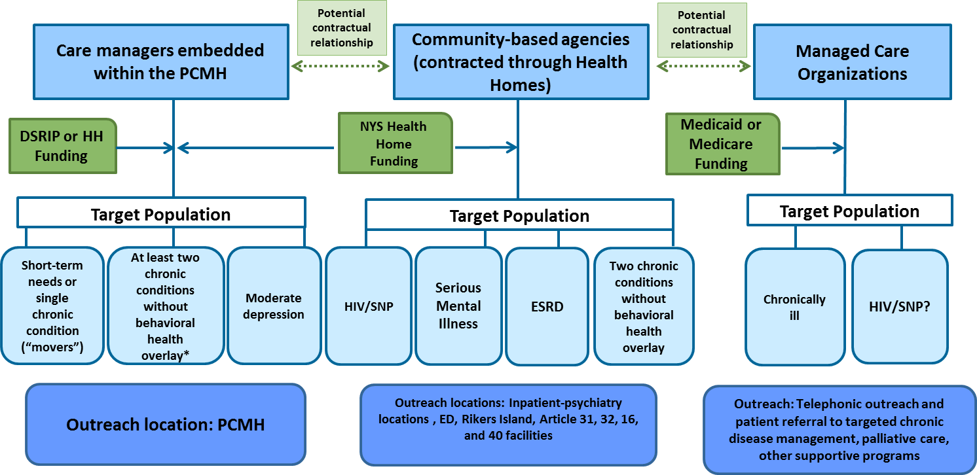
Deeper Dive: Health Home At Risk Intervention
  Health Home At Risk Intervention Program
  Key Roles – PCMH and its Care Managers:
  Identify and manage ‘at risk’ patients with single chronic conditions (“movers”), as defined in 2.a.iii
  Refer patients with special needs to Health Homes for assessment and appropriate services referral
  Contract with Health Homes to provide care management services to PCMH eligible patients who can be effectively managed by PCMH care managers
  Visual Look at Care Management Construct

Slide 26


Update: Cardiovascular Disease, Diabetes, and Asthma Workgroup
At a Glance
Meetings: Held five Work Group meetings on 7/30, 8/4, 8/18, 9/3, and 9/17
Intervention Recommendations to Date
The CVD/Asthma/Diabetes Work Group recommends...
  Cardiovascular Disease
  Diabetes
  Asthma
  Implementing strategies recommended by the Million Hearts initiative for aggressive hypertension control
  Adopting a standard set of treatment and management standards, workflows, and protocols
  Adapting the Million Hearts initiative disease management strategies to diabetes control
  Adopt evidence-based DM treatment guidelines
  Implementing the LEAP amputation prevention intervention as part of the broader patient engagement strategy
  Contracting with a.i.r. bronx to implement its home-based asthma intervention
For all assigned projects, the CVD/Asthma/Diabetes Work Group has noted that attainment of NCQA PCMH Level 3 recognition by primary care providers will be crucial.

Slide 27
Deeper Dive: Cardiovascular Disease
  Million Hearts Initiative
  Program Overview/Goal: The Million Hearts initiative, which is led by the CDC and CMS, provides a range of evidence and practice-based strategies for clinicians to use in hypertension control efforts. These strategies are organized into three areas:
    Actions to Improve Delivery System Design
    Actions to Improve Medication Adherence
    Actions to Optimize Patient Reminders and Supports
  Program Model: The Initiative suggests a wide range of strategies for successfully controlling hypertension. Specific strategies discussed by work group members include:
    Implementing a standard hypertension manual
    Instituting hypertension champions within provider organizations
    Creating hypertension registries for monitoring & tracking patients
    Providing blood pressure checks without an appointment and training additional clinic personnel on taking blood pressure measurements
  Implementation Considerations:
    Identifying and obtaining buy-in for standard hypertension control manual
    Obtaining physician engagement and buy-in; use of incentives
    Coordinating with MCOs on issues such as formularies and 90-day refills
    Identifying staffing model and staffing ratios

Slide 28
Deeper Dive: Diabetes
  Million Hearts Initiative
  Program Model: While the Million Hearts initiative is geared towards hypertension control, work group members agreed that it could be adapted to diabetes with certain modifications. Work group members noted that there will be a few challenges in this adaptation, including:
    Emphasis on diet and exercise in diabetes management
    Diabetes is a multi-organ disease as such more medically complex than hypertension
    Patient self-management and self-efficacy are critically important
    Overlap of diabetes and some mental health disorders
  Implementation Considerations:
    Adapting Million Hearts strategies for diabetes
    Considering whether to implement a standardized diabetes manual
    Obtaining physician engagement and buy-in; use of incentives
    Identifying staffing model and staffing ratios

Slide 29
Deeper Dive: Asthma
  a.i.r. bronx
  Program Overview/Goal: Aims to “improve the quality of life and academic achievement of asthmatic children, helping families break the revolving cycle of poverty that is worsened by chronic disease.” Began in Harlem and has recently expanded to the South Bronx
  Program Model:
  Model provides in home and telephonic support and education for one-year period with follow-up after as needed. Strategies include home visits, health literacy, environmental, legal support, and school-based programs to achieve its goals
    Community Health Workers (CHWs) work with family to customize an Asthma Action Plan for each child
    CHW home visit is used to engage family and conduct environmental assessment of asthma triggers
    Integrated pest management services are free for families
    Legal services to families to address housing problems including mold, roaches, rodents, and eviction are also free to families
  Hospitals and schools refer families to the program
  Staffing: Peer CHWs conduct home visits in languages including Spanish, French, and Mandingo. CHWs are trained in techniques such as motivational interviewing. Caseloads average 125 families per CHW
  Implementation Considerations:
  Determining how the program will interface with care managers and providers
  Considering whether to extend the model to adults with asthma

